Slide 1
Luke 11:28-32
(English Standard Version)

Slide 2
²⁸ But he said, “Blessed rather are those who hear the word of God and keep it!”
²⁹ When the crowds were increasing, he began to say, “This generation is an evil generation. It seeks for a sign, but no sign will be given to it except the sign of Jonah. ³⁰ For as Jonah became a sign to the people of Nineveh, so will the Son of Man be to this generation. ³¹ The queen of the South will rise up at the judgment with the men of this generation and condemn them, for she came from the ends of the earth to hear the wisdom of Solomon, and behold, something greater than Solomon is here. ³² The men of Nineveh will rise up at the judgment with this generation and condemn it, for they repented at the preaching of Jonah, and behold, something greater than Jonah is here.

Slide 3
Steve Martin
in
“The Man with Two Brains”
Give me
a
Sign

Slide 4
The Faithless demand a sign. The Godly live by Faith.
²⁸ .... “Blessed rather are those who hear the word of God and keep it!”
The sign God has already given, is glaringly obvious, but not what the spiritually blind want.
Seeing signs & wonders & hearing God’s word, is no benefit unless we are changed by it
Becoming a Disciple of Jesus is a step of faith. Hear God’s call to repentance & faith, & do it.
The Sign of Jonah (a reluctant prophet)
²⁹ .... “This generation is an evil generation. It seeks for a sign, but no sign will be given to it except the sign of Jonah.
Jonah preached to a godless city (Nineveh) and they repented in a day.

Slide 5
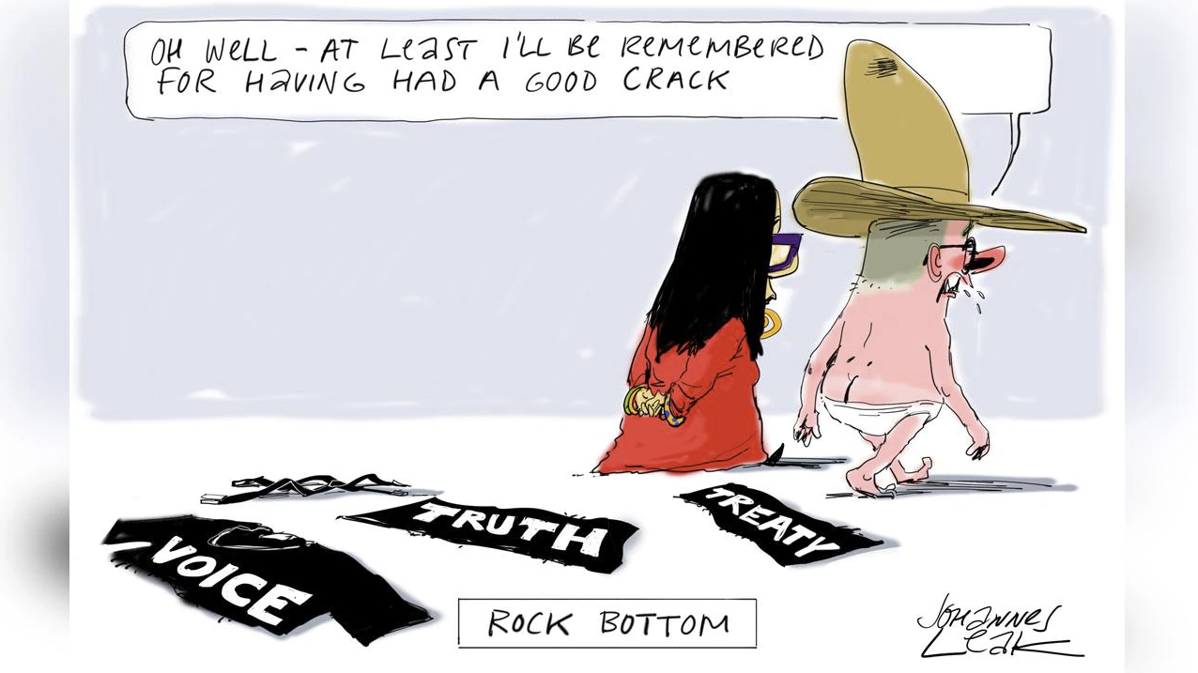

Slide 6
The Faithless demand a sign. The Godly live by Faith.
²⁸ .... “Blessed rather are those who hear the word of God and keep it!”
The sign God has already given, is glaringly obvious, but not what the spiritually blind want.
Seeing signs & wonders & hearing God’s word, is no benefit unless we are changed by it
Becoming a Disciple of Jesus is a step of faith. Hear God’s call to repentance & faith, & do it.
The Sign of Jonah (a reluctant prophet)
²⁹ .... “This generation is an evil generation. It seeks for a sign, but no sign will be given to it except the sign of Jonah.
Jonah preached to a godless city (Nineveh) and they repented in a day.
God is ‘having a go’ at Israel. I have been telling you for years to repent, & you will not listen. But this godless city responded in 1 day, with the word of a reluctant prophet.
God has already spoken. Take notice of what God has said. Listen to His Son (Jesus Christ).
The death and resurrection of Jesus. 3 days in the grave & Raised to Life.
The resurrection of Jesus reveals the greatness (Lordship) of Jesus. No further sign required.
On the Day of Judgment, there is no excuse.
Jesus is greater than Solomon & greater than Jonah. Why will many not listen to Him?
The Bible is not merely a collection of optional ‘life-helps’.
It reveals the Greatness of Jesus, and is the Word of God to be obeyed.
“Faith” is what’s needed – not another sign

